Slide 1
Presented by: Malcolm Earp
and ….Dr. Horstmeyer

Slide 2
Agenda
MOTORcheckUP & FLUIDcheckUP product
Company background
How it works
Why it is unique
The Business case

Slide 3
Product outline
vehicle diagnosis - not just an oil condition check
Checks Coolant and Fuel contamination in Oil
Diagnoses faults with the engine
Scale 1 > 10 analysis - suggests remedies
Plus for Transmission, Power Steering, Brakes
One drop of oil to detect contaminants
German made, Tested, approved & endorsed by the TÜV
EU and international patent protected
Inexpensive fast, reliable and easy to interpret
Easily tailored to exact requirements of KwikFit

Slide 4
Company Structure
German company
Private ownership
Founded in 2006
International launch end of 2012
GmbH
Exclusive Distribution Rights in UK/Eire
UK
JV
Anglo/German automotive consultancy
Independent Motor Parts wholesaler

Slide 5
The core product – customer benefits
Inexpensive proposition to keep vehicle healthy and justifies regular servicing
Solution for heavy duty fleet applications where break-down incurs high risk
Heavily supports warranty proposition
The fair-minded x-sell opportunity
An ultimate booster of customer trust inspection services
A “must do” check for used car buyer – and a value driver for used car seller!

Slide 6
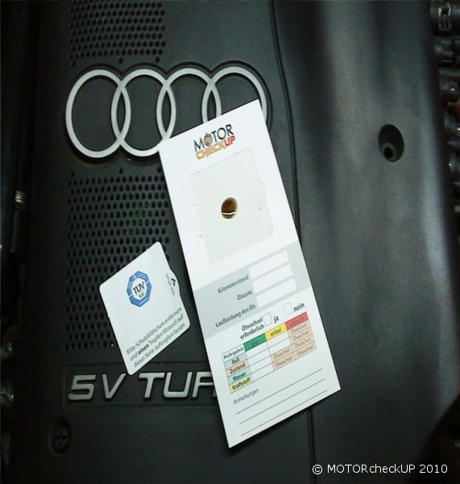
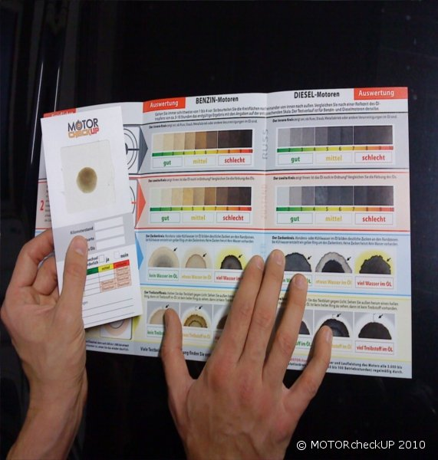
Easy to Use
Open
Dip
Drop
Wait
Check

Slide 7
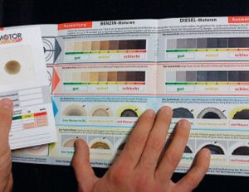
Easy to Interpret

Slide 8
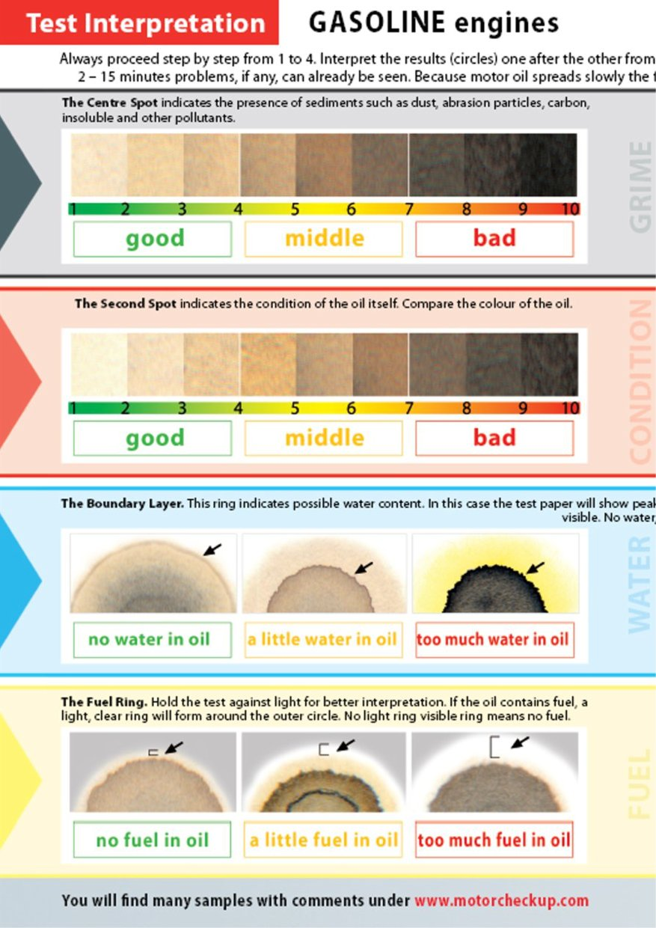
Example Results - Petrol Engine
PETROL
Mileage reading: 45,057 km
km since oil change: 13,474 km
Type: Audi A3 Sportback 1.6
Registration date: 29.06.2007

Slide 9
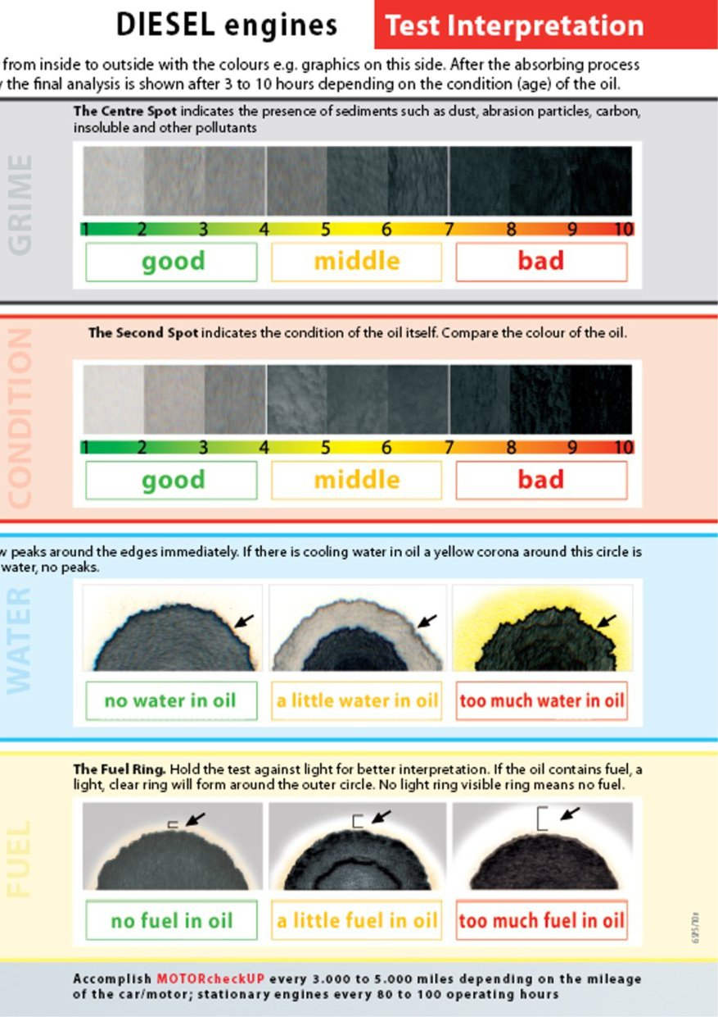
Example Results - Diesel Engine
2~15 minutes.
Mileage reading: 65,476 km
km since oil change : 7,476 km
Type: VW - EOS 2.0 TDI
Registration date : 07.09.2006

Slide 10
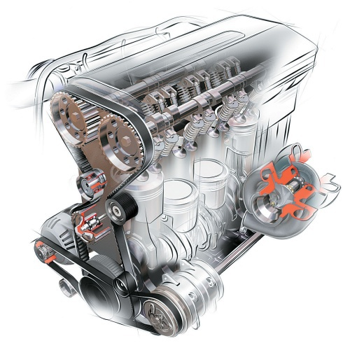
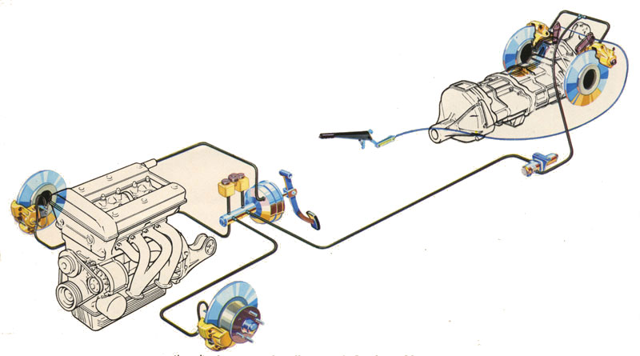
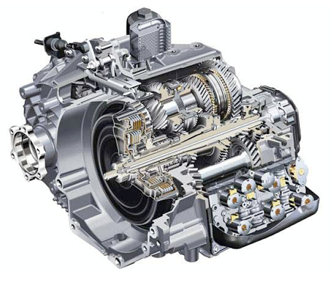
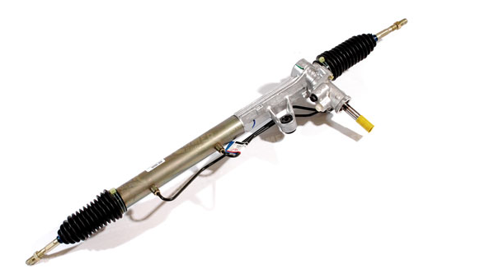
Extended Application

Slide 11
Easy to Interpret

Slide 12
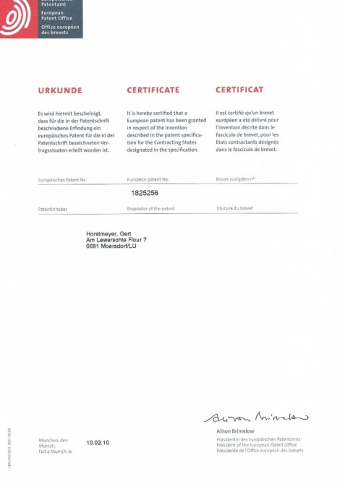
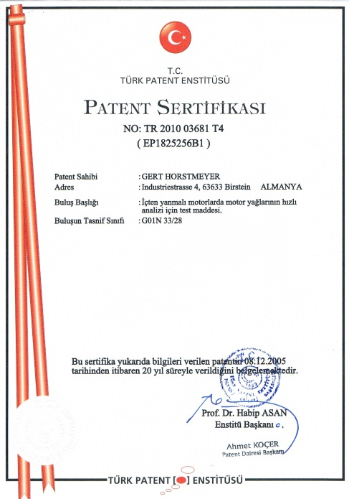
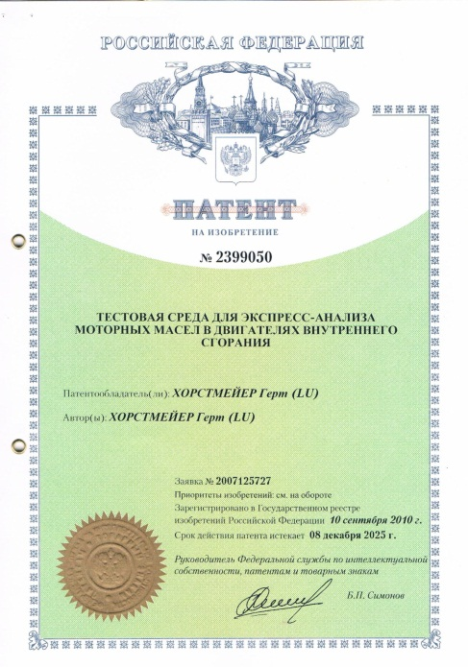
Quality, Authenticity and IP
Unique 3 stage treatment process
Makes possible Fuel and Water/Glycol identification
Full certification by the TŰV
Full European Patent Granted
Counter claims rejected
Other non-EU market patents granted

Slide 13
Competition
X Laboratory analysis
Expensive and time-consuming
Results take several days
Complicated report
X Oil checks
Just oil condition - Can‘t identify coolant/fuel in oil
Potential patent violations
High risk of undermining high margin oil changes

Slide 14
Positive Business case
Vehicle Health Check and DIAGNOSIS process
Think... blood test, like Cholesterol check
Generate Additional Repair Sales
Don‘t give the customer a reason not to change the oil
Sell engine/component investigation, and repair
Give Customer Peace of Mind
Build into warranty and service loyalty plan
Joint marketing promotion with Fuel Retailer
The research....

Slide 15
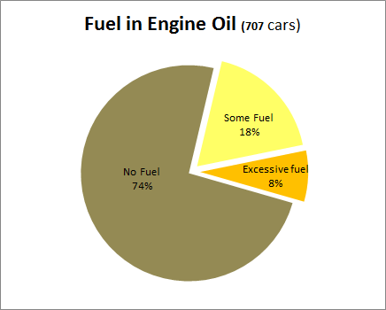
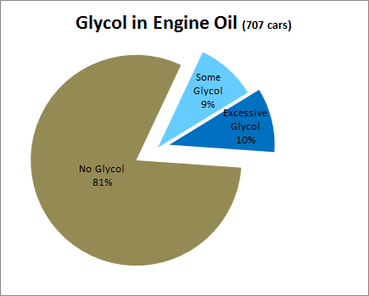
Castrol GTÜ Research (Germany 2011 - 3yr+ PVs)
GTÜ - third largest technical vehicle inspection (MOT) organisation in Germany
If applied to the UK 3yr+ passenger car parc of 25,466,579 (Mostly Private) (SMMT 2012)
If applied to the UK 2yr+ LCV parc of 3.052,660 (Mostly SME) (SMMT 2012)

Slide 16
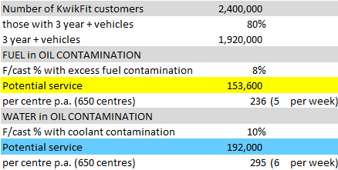
Service Opportunity – Engine
MOTORcheckUP health check encourages regular preventative maintenance to avoid big repair costs
Encourages regular service

Slide 17
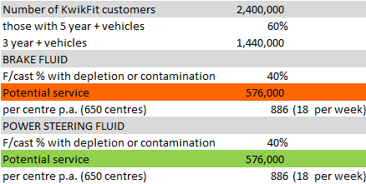
Service Opportunity – Brakes & PAS
MCU research shows 40% of vehicles 5+ years need fluid change or have problems
MOTORcheckUP health check encourages regular preventative maintenance to avoid big repair costs
Encourages regular service

Slide 18
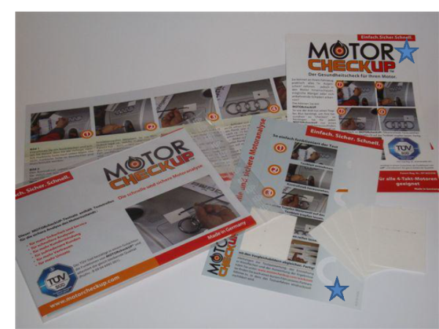
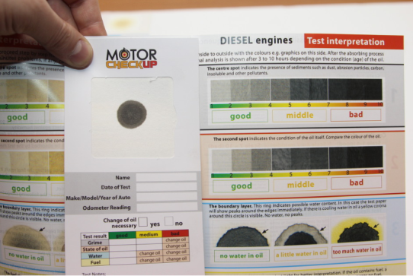
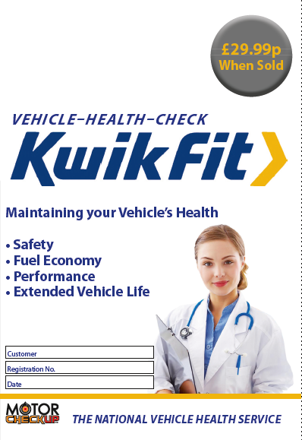
Test options for KwikFit
50-Test pack
Simple single test
Suits tyre fitting centres
No record / interpretation for customer
Single-Test
Simple single test
Customer has record / interpretation
Marketing possibilities
Maxi-Test
Engine oil and brake fluid
Complete Health Check for vehicles
Customer has record / interpretation
Application at larger branches with Master Techs

Slide 19
Summary
Unique product with high stand-alone sales potential
Drives highly profitable x-sell in the core business
Avoids „revenue depletion“ of „ simple oil quality tests“
Potential to drive additional service revenue form insurance/warranty business whilst reducing claims risk
Strengthen customer trust and KwikFit brand loyalty

